Slide 1
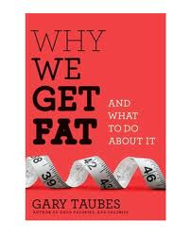
while avoiding carbs. It’s time to turn the food pyramid upside down. This is a book that you will not be able to put down and you will shake your head at how duped we have been. It’s a similar situation to how much effort has been wasted chasing cholesterol values while ignoring what really matters the particles carrying the cholesterol. The National Lipid Association definitely needs to invite Mr. Taubes as a featured speaker at next year’s annual meeting.“ Thomas Dayspring, M.D. September 2011
“I cannot recommend more highly that you pick up Gary Taubes new book Why We Get Fat and What to do About It (A.A. Knoph NY 1011). This book which refutes virtually everything we have been taught about calories and weight gain and makes the case that at least Insulin Resistant humans better start eating a lot more fat
Why We Get Fat, And What To Do About It. This book is so important to us It’s the fundamental teaching tool for all our Insulin Resistant patients. Again no one ever said it better than Dr. Tom Dayspring and we completely agree with what he said. Just to give you a sense of it, we have included a copy of Chapter 13 with yellow highlights. I think you will see why we call Why We Get Fat, And What To Do About It, the BIBLE for our Insulin Resistant patients.
Thanks
EJG

