Slide 1
Chief Steven Pitts, Reno Police Dept.
Dr. James Greenwald, Medical Director, SpecialtyHealth
Robb Wolf, Author: The Paleo Solution
Jackie Cox, BSN, MPA, President/CEO, SpecialtyHealth
FBI ACADEMY
Quantico, VA
September 18, 2012
Resiliency as a Path to Wellness
SpecialtyHealth 330 E. Liberty, Suite 200, Reno, NV 89501 (775) 398-3601
All slides subject to copyright 2002-2012, SpecialtyHealth, Inc. All rights reserved. Reproduction forbidden without permission. www.specialtyhealth.com

Slide 2
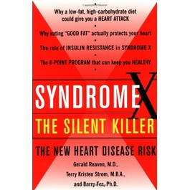
Insulin Resistance as described by Dr. Gerald Reaven
“Due to a combination of genetics and lifestyle, many of us are insulin resistant. That is, certain cells in our body don’t respond efficiently to insulin’s call to accept glucose from the blood. Our pancreas then pumps out extra insulin to correct this problem. Ironically, in doing so it lays the groundwork for another, equally dangerous problem: (Metabolic Syndrome), which is caused by the combination of insulin resistance plus compensatory hyperinsulinemia.”
“The cluster of problems that make up (Metabolic Syndrome)-including elevated triglycerides, low HDL cholesterol and smaller, denser LDL particles-encourages damage to the coronary arteries that can trigger a heart attack. The best way to solve this problem is to attack it at the root that is, to keep insulin levels under control.” Syndrome X, The Silent Killer, Pg. 167
Order book at: http://books.simonandschuster.com/Syndrome-X/Gerald-Reaven-M-D/9780684868639

Slide 3
Gary Taubes - Newsweek: Why the Campaign to Stop America's Obesity Crisis Keeps Failing
The Message Is Wrong – It’s The Sugars!!
Sugars are fattening! “The biology suggests that they are literally fattening – they make us fat, while other foods (fats, proteins, and green leafy vegetables) don’t
(pg. 34)
Left unsaid is the fact that sucrose and high fructose corn syrup have a unique chemical
composition, a near 50-50 combination of two different carbohydrates, glucose and
fructose. And while glucose is metabolized by virtually every cell in the body, the fructose
(also found in fruit, but in much loser concentrations) is metabolized mostly by liver cells.
Some of the fructose is converted into fat, the accumulates in the liver cells, which become
resistant to the action of insulin, and so more insulin is secreted to compensate. The end
results are elevated levels of insulin, which is the hallmark of “insulin resistance” and the
steady accumulation of fat in our fat tissue – a few tens of calories worth per day, leading to
pounds per year, and obesity over the course of a few decades. (pg. 35)
The latest clinical trials suggest that all of us would benefit from fewer (if any) sugars and
fewer refined grains (bread, pasta) and starchy vegetables (potatoes) (pg. 36)
Order magazine at: http://www.thedailybeast.com/newsweek/2012/05/06/why-the-campaign-to-stop-america-s-obesity-crisis-keeps-failing.html

Slide 4
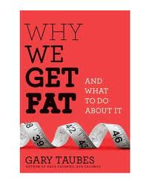
“I cannot recommend more highly that you pick up Gary Taubes new book Why We Get Fat and What to do About It (A.A. Knoph NY 1011). This book which refutes virtually everything we have been taught about calories and weight gain and makes the case that at least Insulin Resistant humans better start eating a lot more fat while avoiding carbs. It’s time to turn the food pyramid upside down. This is a book that you will not be able to put down and you will shake your head at how duped we have been. It’s a similar situation to how much effort has been wasted chasing cholesterol values while ignoring what really matters the particles carrying the cholesterol. The National Lipid Association definitely needs to invite Mr. Taubes as a featured speaker at next year’s annual meeting.“ Thomas Dayspring, M.D. September 2011
Order book at: http://garytaubes.com/

Slide 5
TREATMENT AS USUAL WILL GET YOU KILLED!!!!!!!!!
“RECENT DATA FROM NHANES SHOWS THAT THE SINGLE BIGGEST CAUSE OF MYOCARDIAL INFARCTION IN THE U.S. IS INSULIN RESISTANCE.
IN YOUNG ADULTS PREVENTING INSULIN RESISTANCE IS PREDICTED TO PREVENT 42% OF MYOCARDIAL INFARCTIONS”
Article: LIPOPROTEIN COMPOSITION REGULATES LDL-P by Thomas Dayspring MD ,FACP, FNLA
We must stop thinking about lipids and start counting lipoproteins. (NMR)
“It’s not the passengers, it’s the cars.”

Slide 7
Is There A Simple Way To Identify Insulin Resistance?
Yes: A blood triglyceride/HDL ratio ≥ 3.5 provides a simple means of identifying insulin resistance.
Insulin Resistance occurs early. It is the canary in the coal mine. (20 year IR DM2)
Are you Insulin Resistant??? Do the math!
Insulin Resistance is reversible. (It’s our nation’s biggest public health problem.)
When we are insulin resistant the particle number - LDL-P can be very, very high. That’s what causes the heart attack!
* Tracey McLaughlin, M.D., Gerald Reaven, M.D., Etc. amjcard 2005

Slide 8
The most forceful thing he said, the only time he raised his voice
somewhat, was at the evening presentation when he said: “In trial after trial, in five major trials, it’s the particle number that always most closely tracks risk.” William Cromwell, M.D. SpecialtyHealth Wellness Workshop, September, 2011 (Video #8 at specialtyhealth.com)
It’s not the passengers, it’s the cars!
Dr. Michael Richman
Understanding this critical lipid concept alone could save our cash strapped cities millions and millions of dollars, and help us avoid so many tragic events!

Slide 9
DM

Slide 10
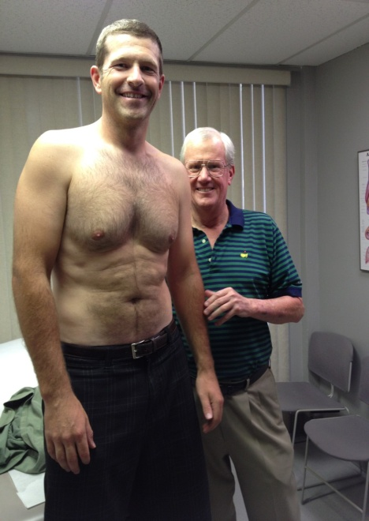
RISK ASSESSMENT
Officer “1” is close to ideal!
He is not fat, but
With a BMI of
About 28 he gets
The “Fat Boy” Letter.
Caliper testing and underwater weighing resolve these issues.
Vo2 Max testing, etc. reveals that he is extremely fit.
Advanced testing, although probably not necessary on this officer, was completed and as expected his LDL-P was under 1000!
His insulin resistance score was very low.
I tell him that he is “metabolically bullet proof”.

Slide 11
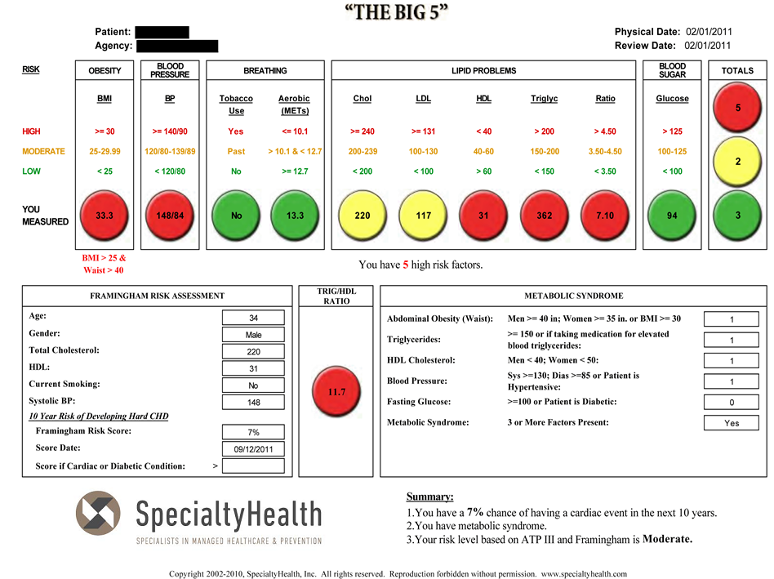
BEFORE THE PROGRAM
33

Slide 12
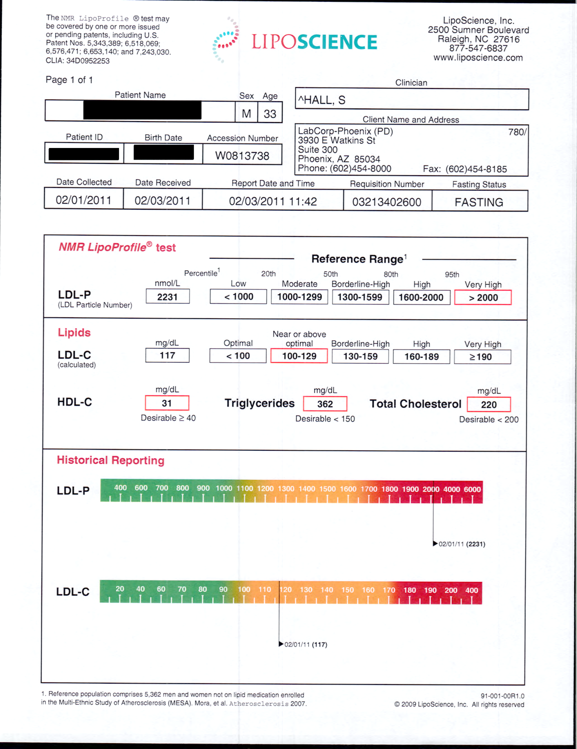

Slide 13
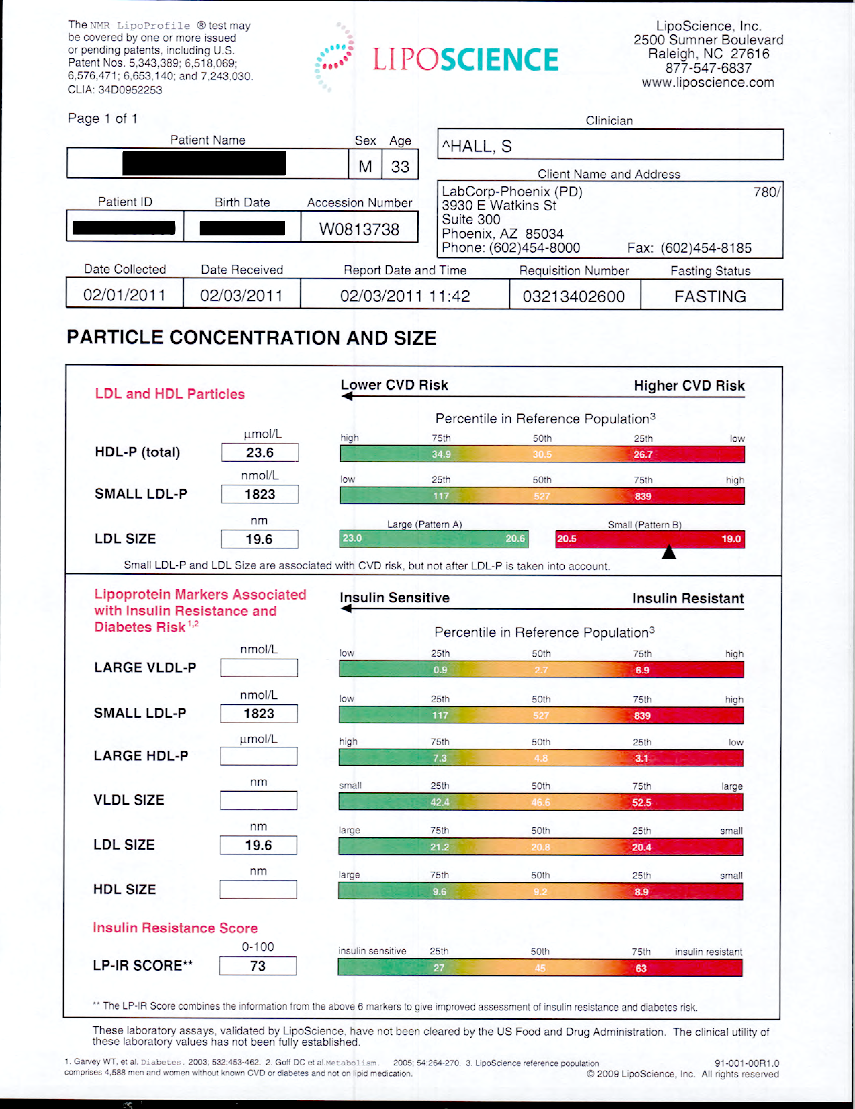

Slide 14
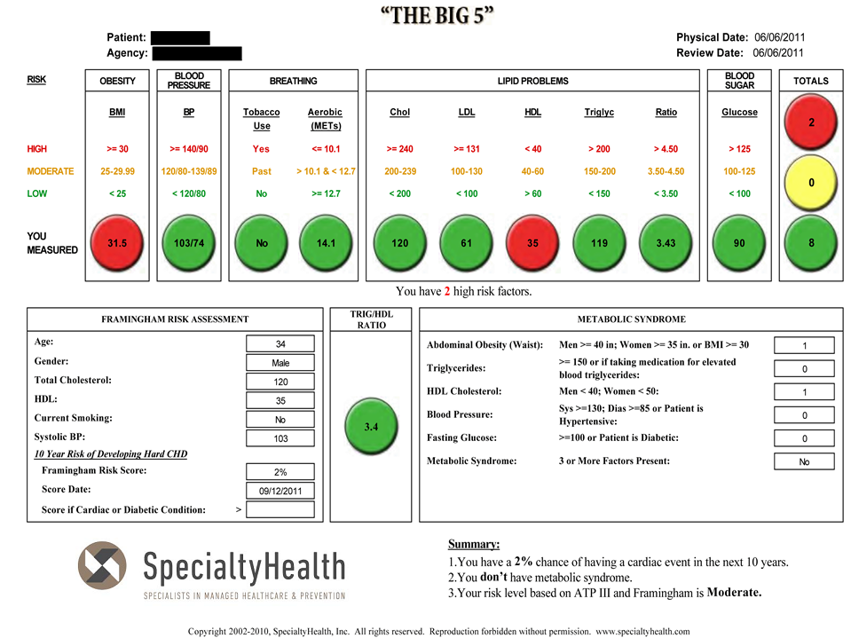
AFTER WELLNESS PROGRAM
33

Slide 15
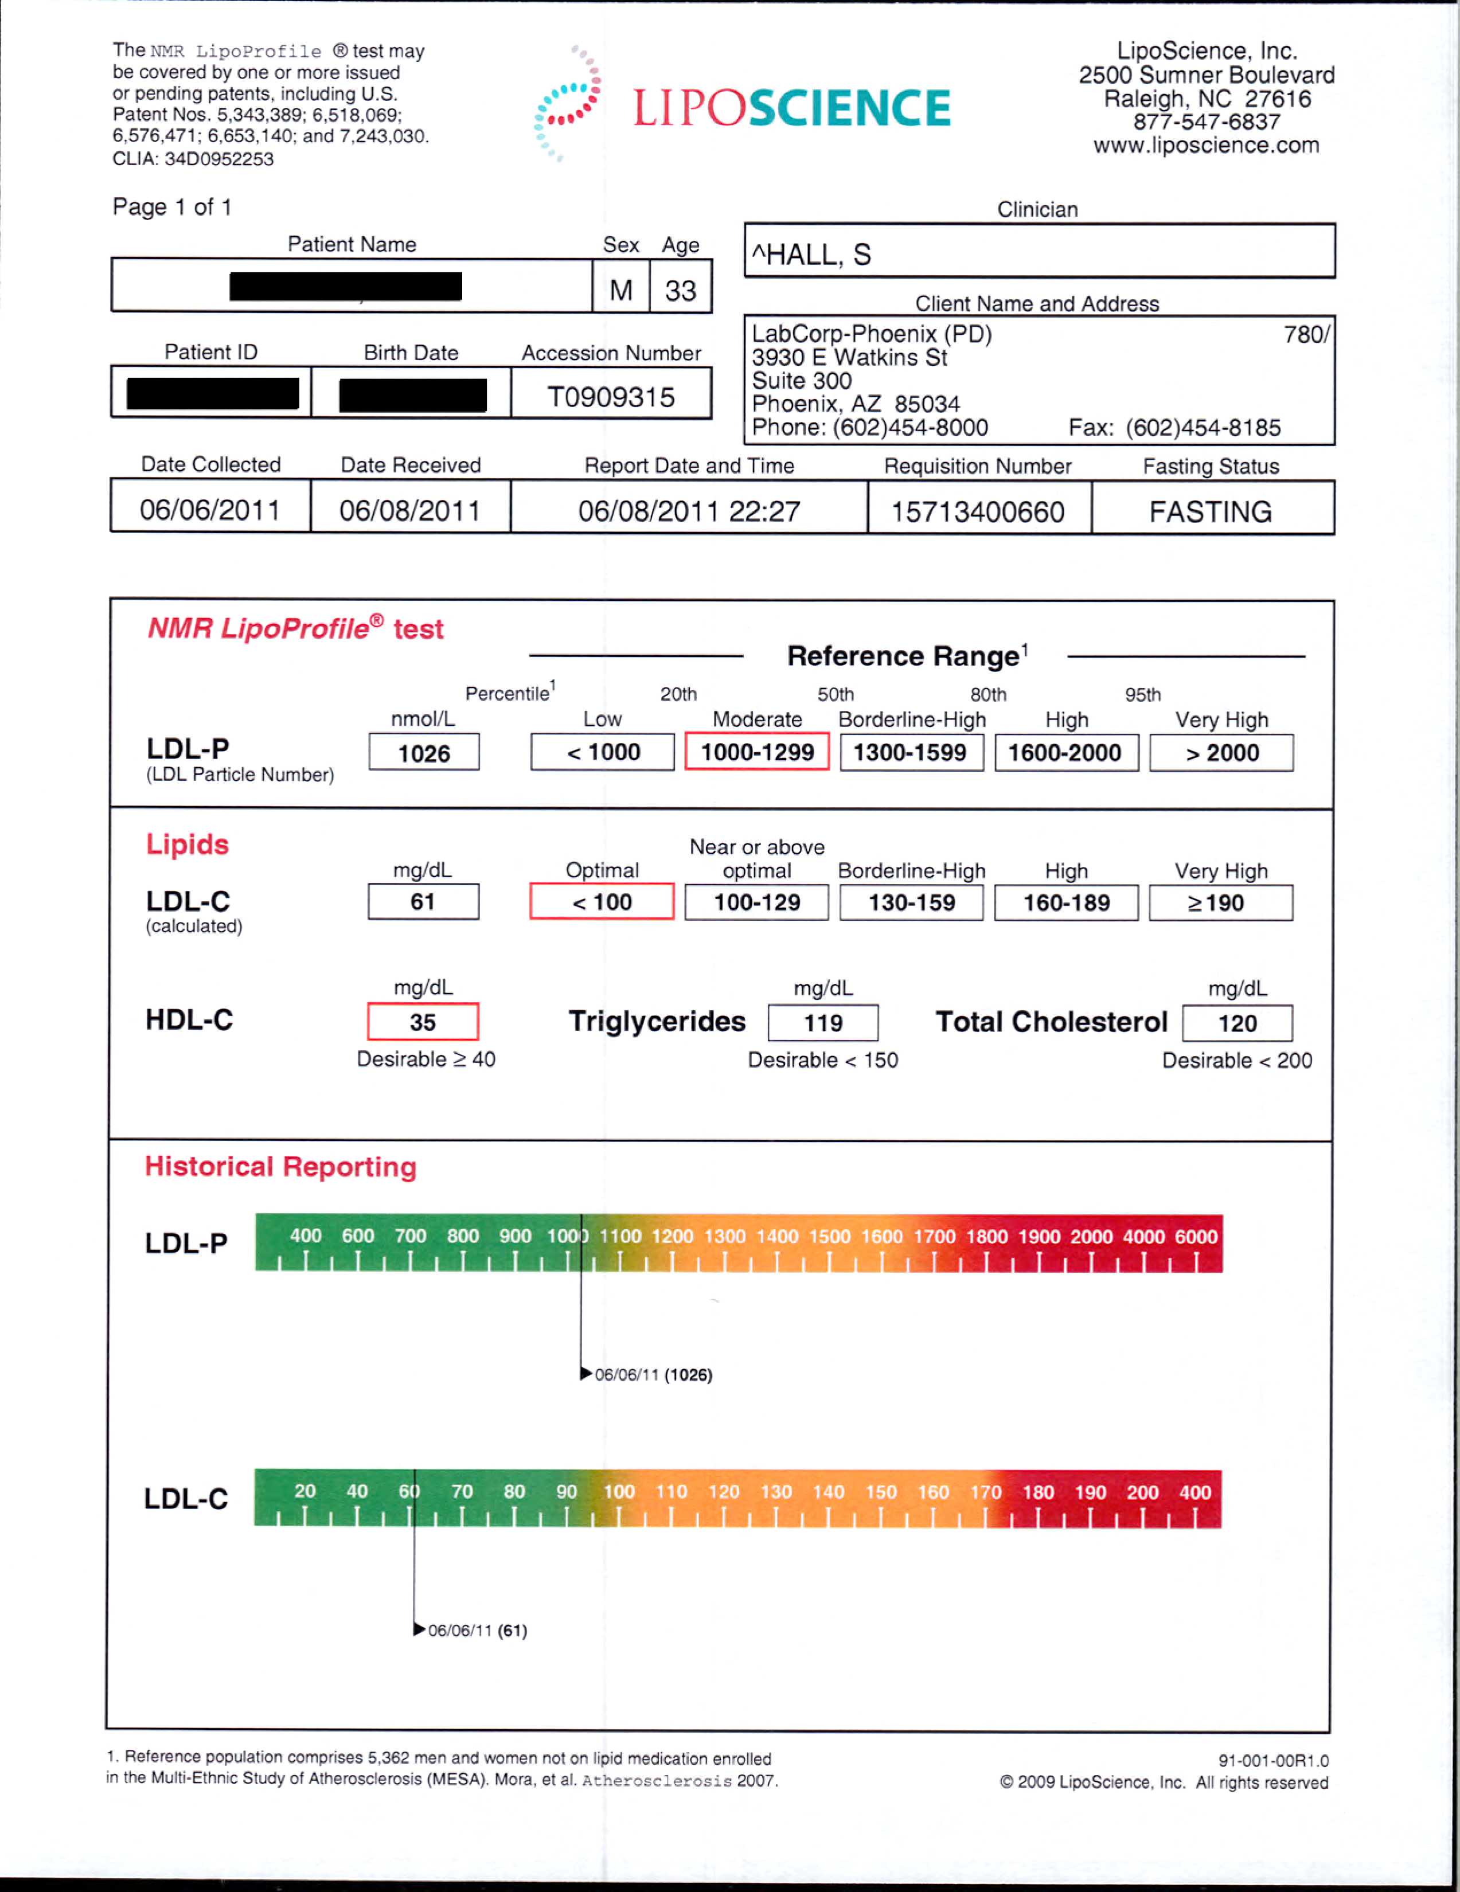

Slide 16
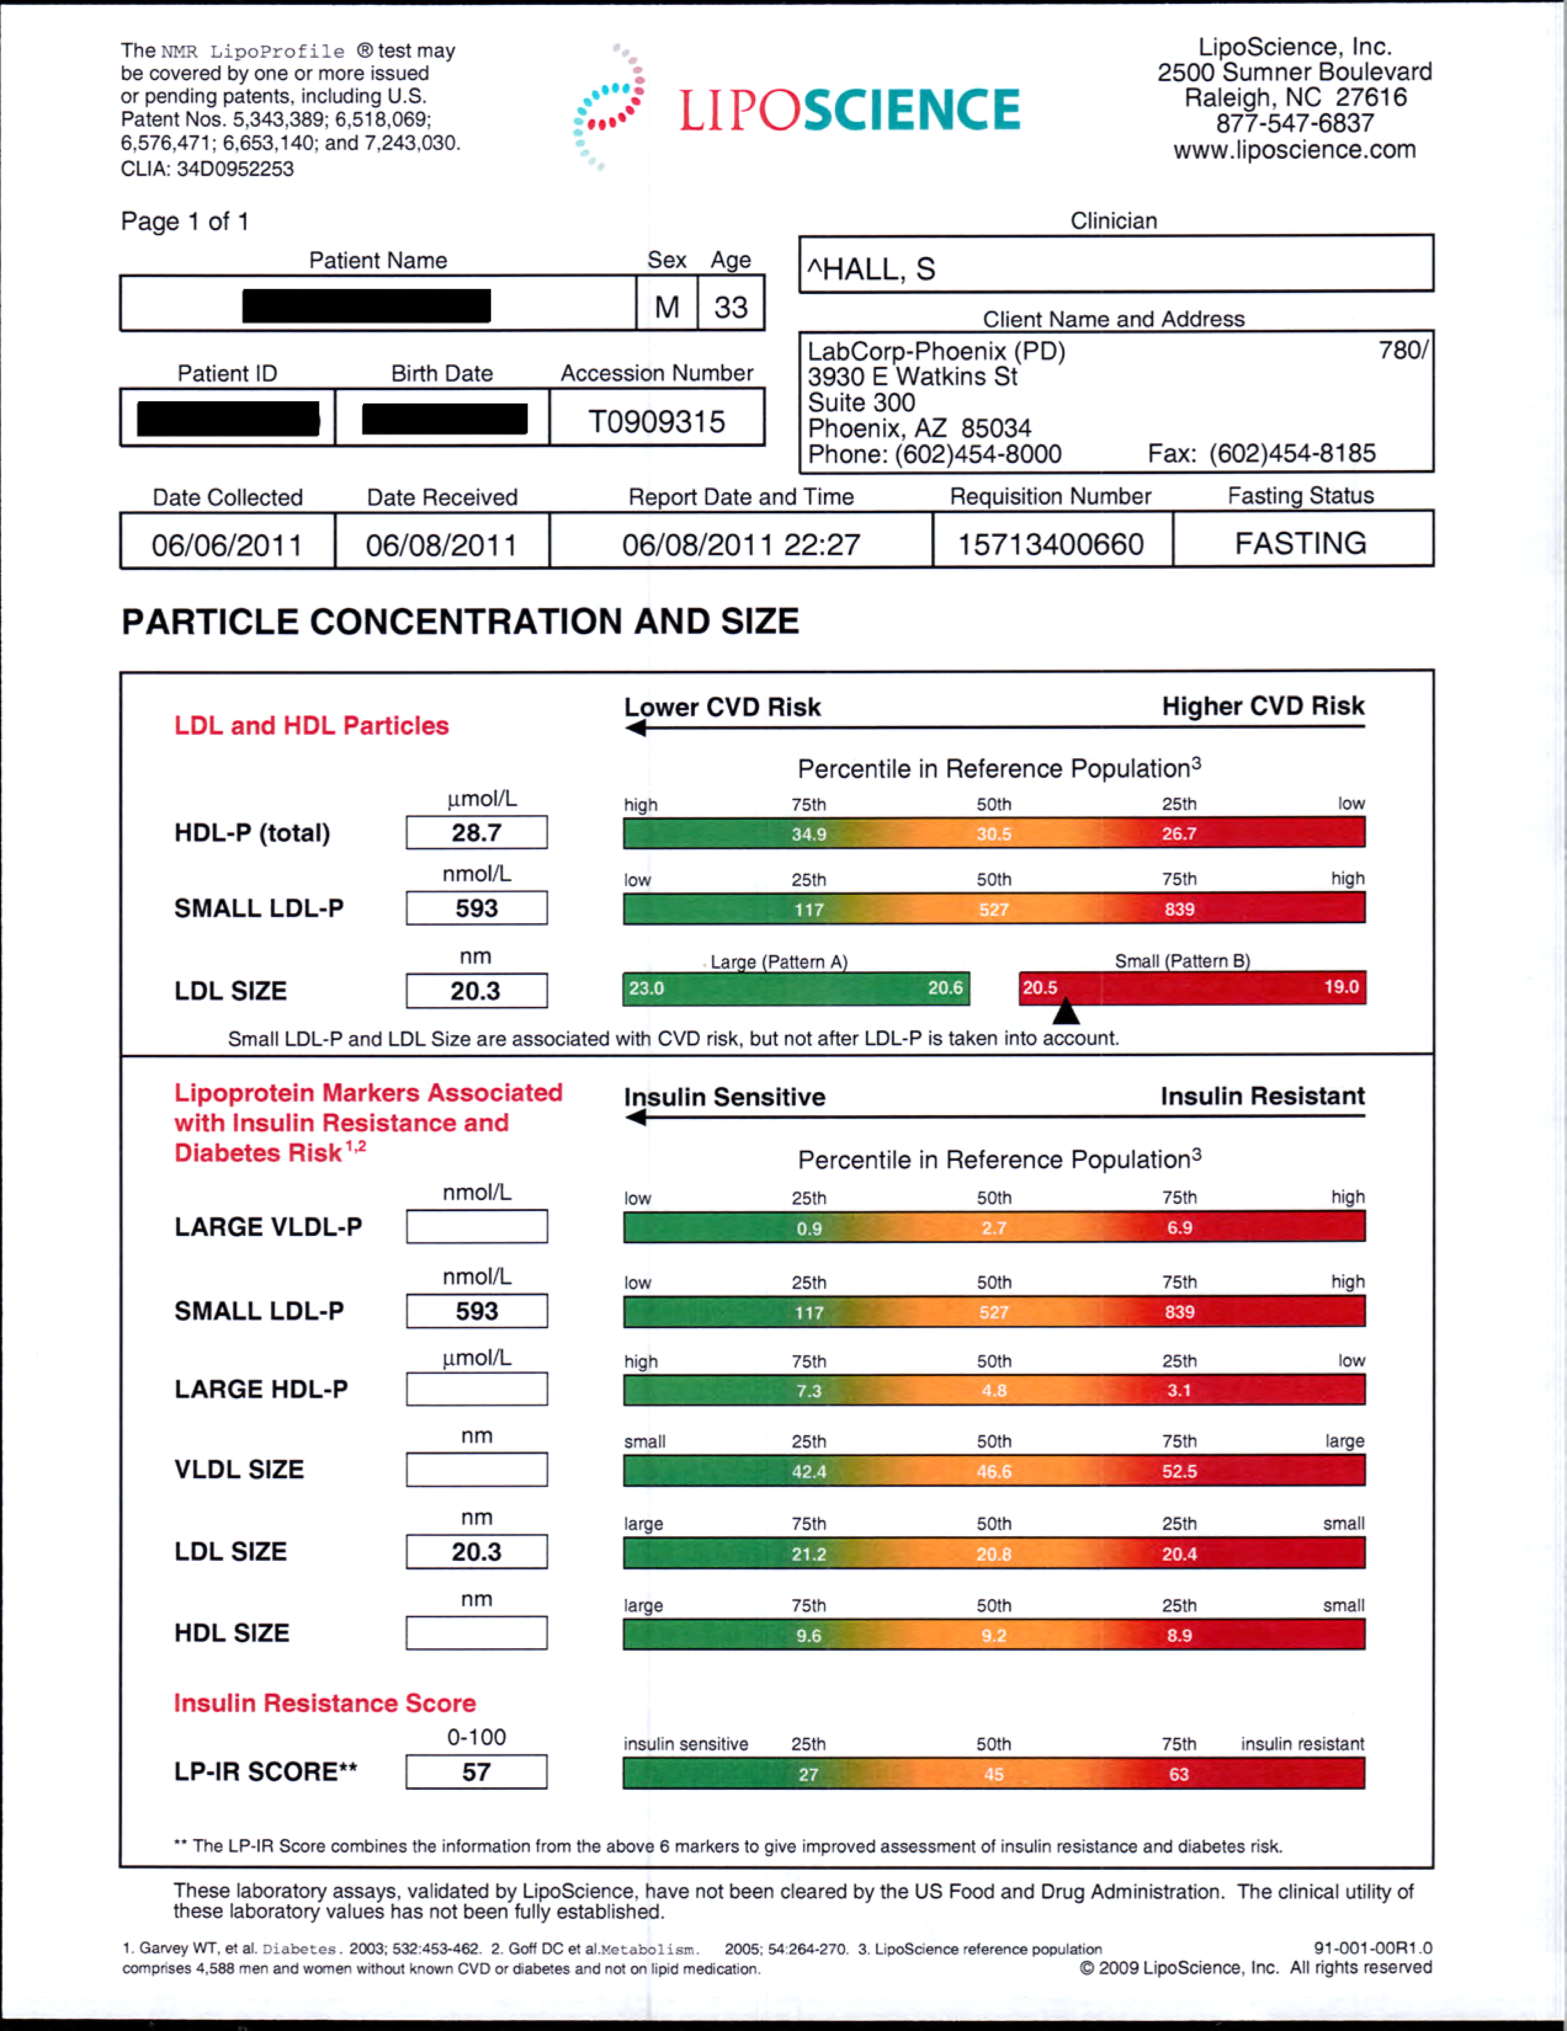

Slide 17
DOES IT WORK? Case Study 2
 | 2/1/11 BEFORE | 6/6/11 AFTER | 4 MONTH RESULT
WEIGHT | 219 | 207 |  | 5.4%
LDL-P | 2231 | 1026 |  | 1205
HDL-P | 23.6 | 28.7 |  | 5.1
LDL-C | 117 | 61 |  | 56
HDL-C | 31 | 35 |  | 4
TRYGLICERIDES | 362 | 119 |  | 243
INSULIN RESISTANCE SCORE | 73 | 57 |  | 16
These numbers are from a 33 year old high risk officer: The results were reached using a Low Carb Diet, Exercise and a cheap Statin. These significant changes were seen in 4 months!
Get them to 1000 – Whatever it takes! (William Cromwell)
Copyright 2002-2012, SpecialtyHealth, Inc. All rights reserved. Reproduction forbidden without permission. www.specialtyhealth.com W:Wellness and Prevention Marketing/Our Best Cases

Slide 18
Insulin Resistance – Our Nation’s Biggest Public Health Problem
Sleep Apnea
Stroke, HTN, Gout
Heart Attack
Obesity
Insulin
Resistance
Diabetes Mellitus II
Polycystic Ovarian Syndrome
Chronic Kidney Disease
Alzheimer's Dementia
Certain Cancers
Smoking

Slide 19
So……how do we correct Insulin Resistance? It’s Surprisingly Inexpensive:
Paleo/Low Carb: (Robb Wolf, Gary Taubes, Dr. Robert H. Lustig – The Bitter Truth, Dr. William Cromwell, Dr. Loren Cordain and Dr. Tara Dall)
Exercise: (Ethan Opdahl, Tammy Lopes, Dr. Kevin Gilmartin, Robb Wolf, Rob Conatser, Dr. Scott Hall, Bill Land (our Navy Seal) and Dr. William Cromwell) )
Weight loss – if necessary: (Ethan Opdahl, Gary Taubes, Dr. Tracey Green, Robb Wolf, Dr. Thomas Dayspring, Dr. Tara Dall and Dr. William Cromwell)
Possible medications, such as Statins or Metformin (Dr. Scott Hall, Dr. Grant
Anderson, Dr. Tara Dall, Dr. Thomas Dayspring, Dr. William Cromwell and
many, many others)
TREAT TO AN LDL-P OF 1000
(Do whatever it takes!) (William Cromwell)
All slides subject to copyright 2002-2012, SpecialtyHealth, Inc. All rights reserved. Reproduction forbidden without permission. www.specialtyhealth.com

