Slide 1
Chief Steven Pitts, Reno Police Dept.
Dr. James Greenwald, Medical Director, SpecialtyHealth
Robb Wolf, Author: The Paleo Solution
Jackie Cox, BSN, MPA, President/CEO, SpecialtyHealth
FBI ACADEMY
Quantico, VA
September 18, 2012
Resiliency as a Path to Wellness
SpecialtyHealth 330 E. Liberty, Suite 200, Reno, NV 89501 (775) 398-3601
All slides subject to copyright 2002-2012, SpecialtyHealth, Inc. All rights reserved. Reproduction forbidden without permission. www.specialtyhealth.com

Slide 2
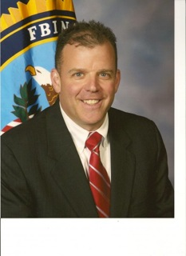
In 2010 SSA Russell Kleber had a heart attack
In January, 2012 Dr. Kevin Gilmartin introduced us.
In March, 2012 Russell came to Reno with two questions:
Could our program have identified him as a high risk patient?
Was his heart attack preventable?
SSA Russell T. Kleber

Slide 3
Question One: Could our program have identified him as a high risk patient? Answer: Yes (with testing)
2 ½ years before the MI

Slide 4
Question Two (Was the heart attack preventable?)
Answer: Hindsight is 20/20. We are not here to second guess anyone! Current thinking is that Heart Disease is not only preventable, it’s reversible.
Especially with the Police and Firefighters (high risk people), we take an aggressive, proactive approach. We test early (NMR), we treat early.
We seek out the high risk patient and we apply the systems approach. (S.P.)
We treat them like an athlete.

Slide 5
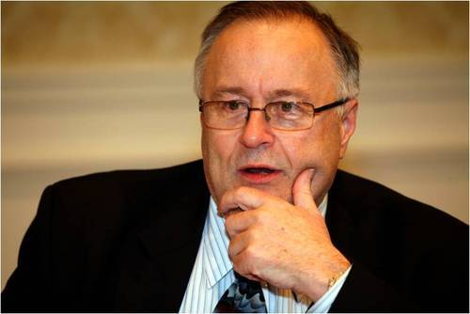
Thomas Dayspring, M.D.
Dr. Dayspring is the most requested lipid educator in the United States.
Please watch video’s #1-7 with Gary Taubes at: www.specialtyhealth.com
Our treatment with Russell was especially aggressive! This is called secondary prevention and included Dr. Tom Dayspring and HDL labs to look at every conceivable variable, including the genetic. Russell's routine labs (post MI) looked great. Advanced testing, however, clearly showed we had a ways to go. Russell has lost weight (low carb diet); he has gained great confidence – he is running now; and he is close to his LDL-P particle goal. We will strive to get him to an LDL-P of 750. Quite a turnaround! I love this program…you get e-mails like this! “Greenie, thank you so much, God bless you and your team, I am so grateful that we have connected, I have hope that my heart disease can be treated. Of course my agent (cop) mentality drives me to knowledge, understanding and WHY and what can I do to help myself and others. The videos are outstanding!!”
SSA, Russell T. Kleber, March 2012

Slide 6
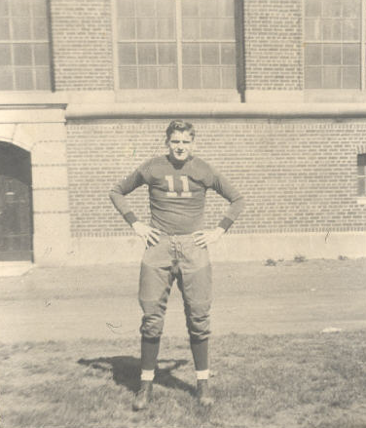
Dedication
To Edward Greenwald
and all the public safety
guys and gals who made
our wellness program
possible.
Thank you,
greenie@specialtyhealth.com
Edward J. Greenwald University of Michigan Athletic Fields, circa 1930.
Not long after this picture was taken, he joined the FBI.
“It’s the best job I ever had”

Slide 10
What happened to my dad – happens to too many of you. Too many Police Officers die early from preventable diseases. (mostly cardiovascular) I have actually been told “If I die, it’s no big deal - just roll me into a ditch!”
Gentlemen, your families need you!
On average our police live 8 years less than the rest of the population. (Numbers vary)
I want all of you to get all the years you have coming to you. EJG
I want to show you how the medical piece (one part of the system) can contribute to that goal.

Slide 12
Compression of Morbidity
X
Quality of Life
X
Ideal
10
30
50
70
90
TIME
Notes:
Copyright 2002-2012, SpecialtyHealth, Inc. All rights reserved.
Reproduction forbidden without permission. www.specialtyhealth.com
W:Wellness and Prevention Marketing/Compression of Morbidity

Slide 13
Insulin Resistance – Our Nation’s Biggest Public Health Problem
Sleep Apnea
Stroke, HTN, Gout
Heart Attack
Obesity
Insulin
Resistance
Diabetes Mellitus II
Polycystic Ovarian Syndrome
Chronic Kidney Disease
Alzheimer's Dementia
Certain Cancers
Smoking

Slide 14
The Early Years
Two big mistakes: One great decision
Mistake #1: Nutrition - In the beginning we weren’t even close!
I believed that we got fat because we ate too
much and exercised too little. (GT)
2. I believed that fat made fat. (A.D.A), (A.H.A)
3. And I also believed that a calorie was a calorie.
In other words, I believed in “Energy Balance”.
(David Ludwig, JAMA, June 27, 2012, Vol 307, No 24, )
(Robert Lustig, The Bitter Truth - YouTube)

Slide 15
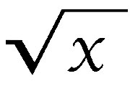
Mistake #2: I believed early on that with a routine history and physical and routine lab we could accurately assess and manage risk.
HUGE mistake: Fortunately, we didn’t hurt anybody.
To quote my colleagues:
In 2003 Dr. Brad Bales said, “Treatment as usual will get you killed”.
2004 Robert Superko said, “½ of the 1.5 million people who have a heart
attack every year in our country have normal cholesterol levels (by routine
testing)”. We Must Do Better!
2006 Dr. Finley Brown, “Insulin resistance is the major cause of heart attack and most other “”diseases of civilization”” Routine testing is way underpowered!!
2011 Dr. Thomas Dayspring stated, “Unfortunately, I know lots of lipid guys and gals, even certified lipidologists, who think they can look at the various lipid concentrations or ratios and very accurately guess whether atherogenic lipoprotein assays ( apo-B or LDL-P) would be normal or abnormal. If I can be blunt: anyone believing that is delusional!”
You would be better off flipping a coin!
That is why my patients get NMR particle concentrations.
Now we look for a reason to move to advanced testing – I favor the NMR by LipoScience.
Perhaps appropriate testing is a better way describe it. HDL is our advanced test.
B.S.

Slide 16
“2007”
By 2007 we had corrected our two mistakes.
(The program had become very strong.)
Now Low Carbohydrate/Paleo is our nutrition philosophy.
Low Carb / Paleo
Gary Taubes Dr. Boyd Eaton
Dr. Loren Cordain
Robb Wolf (2011)
We were testing appropriately - particularly using the NMR!

Slide 17
One Great Decision
Kevin Gilmartin
takes over the behavioral portion of the Wellness Program.
One firefighter,
a marathon runner, carrying all his equipment reached the
78th floor!
--ABC News
Notes:
I am privileged to be able to take care of these guys.
The stereotype of the lazy, donut eating cop is so horribly incorrect
These are special people who very well might lead us out of serious medical trouble by their example.
Reproduction is forbidden without written
permission from SpecialtyHealth Inc.
Cardiac Wellness Program ©

Slide 18
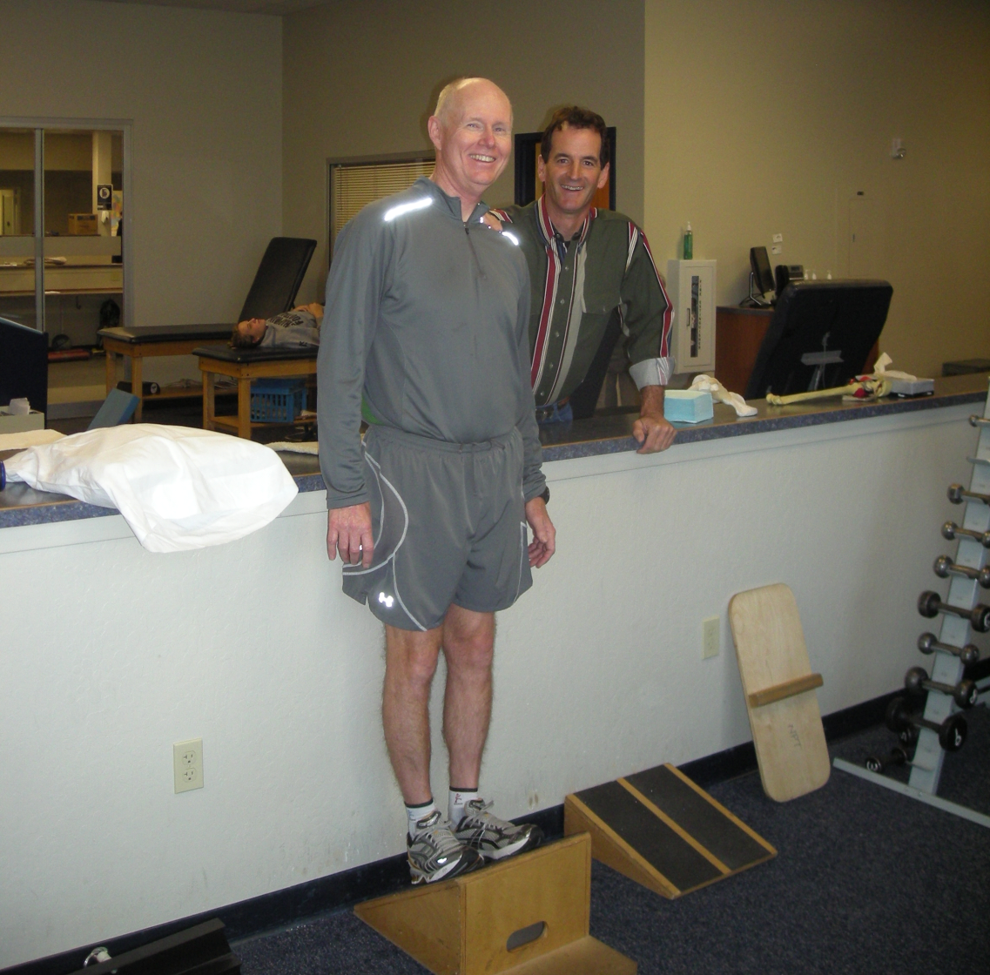
Kevin Gilmartin PhD. - Marathon Training with Gene Cudworth, RPT, at Nevada Physical Therapy
Dr. Kevin Gilmartin (our mentor) understands these issues:
Carbs…lead to
Insulin….leads to
FAT
And therefore insulin resistance!

Slide 19
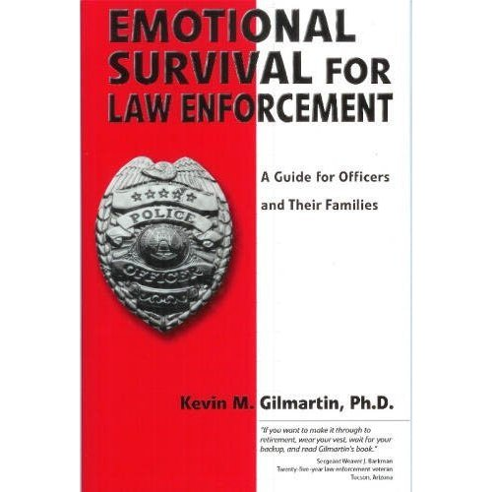
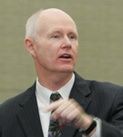
Dr. Gilmartin spent 20 years working in law enforcement before beginning a consulting career as a behavioral scientist. He is nationally known for his work with law enforcement agencies throughout the United States and Canada. He is the recipient of the International Association of Chiefs of Police/Parade Magazine and Office Service Award for his work in hostage negotiations and police psychology.
Order book at: http://emotionalsurvival.com/book_order.htm

Slide 20
Look for our article in an upcoming issue of The Police Chief.
Resiliency as a Path to Wellness
Written by:
Chief Steven Pitts, Reno Police Dept.
Dr. James Greenwald, Medical Director, SpecialtyHealth
Robb Wolf, Author: The Paleo Solution
Jackie Cox, BSN, MPA, President/CEO, SpecialtyHealth
View at: http://www.policechiefmagazine.org/
Chief Steve Pitts, Reno Police Dept.

Slide 21
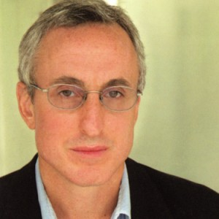
Gary Taubes: Why the Campaign to Stop America's Obesity Crisis Keeps Failing
In the May 7, 2012 cover story for Newsweek, Why We Get Fat author Gary Taubes discusses the research that has been ignored and the mistakes that have been made by America’s “anti-obesity establishment” in their efforts to curb the nation’s growing weight problem. As Taubes explains, current campaigns to battle obesity rely on centuries-old research. The solution, he says, may rely on “changing the entire American food economy and rewriting our beliefs about what constitutes a healthy diet”.
Order magazine at: http://www.thedailybeast.com/newsweek/2012/05/06/why-the-campaign-to-stop-america-s-obesity-crisis-keeps-failing.html

Slide 22
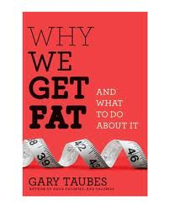
“I cannot recommend more highly that you pick up Gary Taubes new book Why We Get Fat and What to do About It (A.A. Knoph NY 1011). This book which refutes virtually everything we have been taught about calories and weight gain and makes the case that at least Insulin Resistant humans better start eating a lot more fat while avoiding carbs. It’s time to turn the food pyramid upside down. This is a book that you will not be able to put down and you will shake your head at how duped we have been. It’s a similar situation to how much effort has been wasted chasing cholesterol values while ignoring what really matters the particles carrying the cholesterol. The National Lipid Association definitely needs to invite Mr. Taubes as a featured speaker at next year’s annual meeting.“ Thomas Dayspring, M.D. September 2011
Order book at: http://garytaubes.com/

Slide 23
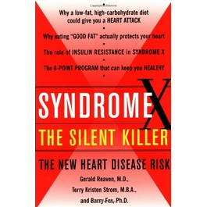
Insulin Resistance as described by Dr. Gerald Reaven
“Due to a combination of genetics and lifestyle, many of us are insulin resistant. That is, certain cells in our body don’t respond efficiently to insulin’s call to accept glucose from the blood. Our pancreas then pumps out extra insulin to correct this problem. Ironically, in doing so it lays the groundwork for another, equally dangerous problem: (Metabolic Syndrome), which is caused by the combination of insulin resistance plus compensatory hyperinsulinemia.”
“The cluster of problems that make up (Metabolic Syndrome)-including elevated triglycerides, low HDL cholesterol and smaller, denser LDL particles-encourages damage to the coronary arteries that can trigger a heart attack. The best way to solve this problem is to attack it at the root that is, to keep insulin levels under control.” Syndrome X, The Silent Killer, Pg. 167
Order book at: http://books.simonandschuster.com/Syndrome-X/Gerald-Reaven-M-D/9780684868639

Slide 24
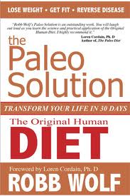
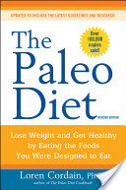
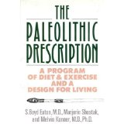
THE PALEO GUYS
Robb Wolf: An expert on Paleolithic nutrition and author of the New York Times Best Selling book "The Paleo Solution: The Original Human Diet". He is also host of a weekly internet podcast called "The Paleo Solution", with Greg Everett. Robb lives in Reno!!
Dr. Loren Cordain: A Professor in the Department of Health and Exercise Science at Colorado State University. His research emphasis over the past 15 years has focused upon the evolutionary and anthropological basis for diet, health and well being in modern humans. Dr. Cordain's scientific publications have examined the nutritional characteristics of worldwide hunter-gatherer diets as well as the nutrient composition of wild plant and animal foods consumed by foraging humans. Over the past five years his work has focused upon the adverse health effects of the high dietary glycemic load that is ubiquitous in the typical western diet. He has lectured extensively on the "Paleolithic Nutrition" concept world wide, and has written three popular books (The Paleo Diet, John Wiley & Sons; The Paleo Diet for Athletes, Rodale Press; The Dietary Cure for Acne) summarizing his research findings.
Dr. S. Boyd Eaton: In 1985, he and Melvin Konner, both of Emory University,, published a key paper on Paleolithic nutrition in the New England Journal of Medicine, [which caused the concept to gain mainstream medical attention.[Three years later, S. Boyd Eaton, Marjorie Shostak and Melvin Konner published a book about this nutritional approach, which was based on achieving the same proportions of nutrients (fat, protein, and carbohydrates, as well as vitamins and minerals) as were present in the diets of late Paleolithic people, not on excluding foods that were not available before the development of agriculture. As such, this nutritional approach included skimmed milk, whole-grain bread, brown rice, and potatoes prepared without fat, on the premise that such foods supported a diet with the same macronutrient composition as the Paleolithic diet.] In 1989, these authors published a second book on Paleolithic nutrition.
Robb Wolf, Dr. Loren Cordain, Dr. Boyd Eaton
. In Search of the Perfect Human Diet (C.J. Hunt)
Order video at: Diet:http://perfecthumandiet.us/
Order book at: http://robbwolf.com/about/press/

Slide 25
S. Boyd Eaton, M.D. et,al (1988) Stone Agers in the Fast Lane: Chronic degenerative Diseases in Evolutionary Perspective.
From a genetic standpoint, humans living today are Stone Age hunter-gatherers displaced through time to a world that differs from that for which our genetic constitution was selected. Unlike evolutionary mal-adaptation, our current discordance has little effect on reproductive success; rather it acts as a potent promoter of chronic illnesses; atherosclerosis, essential hypertension, and cancers, diabetes mellitus, and obesity among others. These diseases are the results of a myriad of bicultural influences lifestyle factors-that include nutrition, exercise, and exposure to noxious substances. Although our genes have hardly changed, our culture has been transformed almost beyond recognition during the past 10,000 years, especially since the Industrial Revolution. There is increasing evidence that the resulting mismatch fosters “diseases of civilization” that together cause 75 percent of all deaths in Western nations, but that are rare among persons whose lifeways reflect those of our preagricultural ancestors.

Slide 26
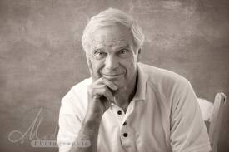
Despite the achievements of science and technology, we remain collectively fearful of diseases that available evidence suggests were uncommon, rare, or unknown in the Late Paleolithic era. In order to regain relative freedom from these illnesses, we need to take a step backward in time. For each disorder, we may anticipate increasingly sophisticated and effective treatments, but the crucial corrective measure will almost certainly be prevention. This will entail reintroduction of essential elements from the lifestyle of our Paleolithic ancestors. S. Boyd Eaton, et al. (1988)
Paleo is so big!
It is perfect for police and fire.
(exercise and sleep)

Slide 27
WITH NO HESITATION AT ALL, WE JUMP ONTO THE SHOULDERS OF GIANTS.
We borrow from the best, and we bring them to Reno to capture them on video.
Please let me introduce you to our experts. They are extraordinarily generous people:

Slide 28
OUR OUT OF STATE EXPERTS!
Dr. Finley Brown – Chicago, IL
Dr. Gerald Reaven – Stanford, CA*
Dr. William Cromwell – North Carolina*
Dr. Thomas Dayspring – New Jersey*
Gary Taubes – Oakland, CA*
Dr. Tara Dall – Wisconsin*
Dr. Kevin Gilmartin – Arizona/Oregon
Dr. Peter Attia – San Diego*
Dr. Robert Lustig – UCSF
Dr. Andreas Eenfeldt – Sweden
Dr. Loran Cordain – Colorado
Dr. Robert Braidwood - Chicago
* Please visit www.specialtyhealth.com to view our amazing collection of these experts’ videos such as
Dr. Attia’s - The War on Insulin, Dr. Lustig’s -The Bitter Truth and SpecialtyHealth’s –
Physical Survival for Fire Fighters and Law Enforcement and special interviews with
our experts. Also see references to books like Gary Taubes’ Why We Get Fat and What
To Do About It, and Dr. Kevin Gilmartin’s book Emotional Survival for Law Enforcement.
* These 6 experts are available at our website
Copyright 2002-2012, SpecialtyHealth, Inc. All rights reserved. Reproduction forbidden without permission. www.specialtyhealth.com

Slide 29
OUR LOCAL EXPERTS! (Teammates)
Dr. Gary Abrass– Oncology
Dr. Grant Anderson – Lipidologist
Dr. Kosta Arger - Cardiologist
Dr. Steven Atcheson - Rheumatologist
Dr. Malcom Bacchus - Neurology
Dr. B. Bottenberg – Lipidologist
Dr. Conor Buckley – Family Practice
Mr. Rob Conatser – Strength Training
Dr. Fred Fricke – Gastroenterology
Dr. Tracey Green – Bariatric and Nutrition
Dr. Scott Hall – Family Practice and Sports Medicine
Mr. Randy Jacobe – Physical Therapy
Mr. Bill Land – Exercise Consultant
Division Chief, Tammy Lopes – Strength and Nutrition
Dr. Michael Lucia – Pulmonary/Sleep Expert
Ethan Opdahl – Exercise Trainer
Dr. Charles Quaglieri – Neurology
Dr. Charles Virden – Plastic Surgery
Mr. Robb Wolf – Research Biochemist, Strength Coach and Author
Copyright 2002-2012, SpecialtyHealth, Inc. All rights reserved. Reproduction forbidden without permission. www.specialtyhealth.com

Slide 30
So…..we did some videos: Obesity is a hormonally-driven disorder of fat accumulation. See Video # 17 and my favorite: We can predict Type II Diabetes 15 – 20 year in advance. See Video # 19
Dr. Tara Dall Video’s # 11- 20
View at: www.specialtyhealth.com
Shortcut: 11 – 20:Dr. Tara Dall
1 – 3: Dr. Thomas Dayspring/Gary Taubes
Final Exam: Dr. William Cromwell Video #8

Slide 31
10 Important Things Our Experts Have Taught Me
1. It’s not the Passengers, it’s the Cars. (wc, fb, td)
“LDL-P is the number for me.” In the insulin resistant patient especially, LCL-C (the routine cholesterol number) can be low and fool you.
Don’t get bagged – it’s the particle number that we need, LDL-P.
2. Sugar is “toxic”. (rl)
Fructose is alcohol without the buzz. So, we have a choice – beer belly or sugar belly. Sugar and high fructose corn syrup are the first to
go. Both carbs and alcohol drive the triglyceride up. See Robert Lustig’s The Bitter Truth.
3. Carbs drive insulin drives fat. (gt)
Diabetes and obesity are two sides of the same coin.
4. The problem is not the fats in our diet! (td, gt)
The problem is the carbohydrates that are converted to fats in our liver that not only make us fat, but also cause so many other
problems. See “The Body”.
5. A calorie is not a calorie. (gt, rl, td) *Dr. David Ludwig, JAMA
It’s not a calories in/calories out balance issue; it’s what the calories do in your unique hormonal milieu. It differs from
person to person and at different times of our lives.

Slide 32
6. It’s difficult for the insulin resistant patient to lose weight by burning fat. (gt)
Rising insulin levels keep fat locked up in the fat cell. We must attack the root cause of
high insulin levels first. (gr) This is the number one reason why low fat, low calorie diets fail.
7. Obesity is a hormonally driven disorder of fat accumulation (insulin is the hormone). (gt)
It’s not gluttony, it’s not sloth, it’s not a lack of discipline, as was implied about New Jersey’s
Governor Christi – he’s overweight, therefore, undisciplined, and therefore, not qualified to be
President. This is bad thinking and so unfair. (td)
8. It’s good to exercise every day that you eat. (wc)
The first twenty minutes don’t count. Exercise promotes increased muscle insulin sensitivity.
9. We can see type II diabetes coming fifteen to twenty years in advance. (many)
So much of this trouble is reversible if caught at the insulin resistant stage. See “Our Best Case
Ever”.
10. Heart attacks happen when we have a combination of bad lipids (elevated LDL-P) and inflammation
(often increased insulin levels). (many)
So, elevated triglycerides, low HDL, and high LDL-P make up the atherogenic triad. Trouble is
coming! If a doctor tells you he can accurately assess your real risk from routine lab work, he is
delusional! (td)
All slides subject to copyright 2002-2012, SpecialtyHealth, Inc. All rights reserved. Reproduction forbidden without permission. www.specialtyhealth.com

Slide 33
Lipids Briefly
Lipidology - The exciting young science that gives us the best view through a “Magic Window” revealing the earliest evidence of human disease.
Adapted from Dr. Tara Dall
The National Lipid Association is only 10 years old. Its leaders have been so incredibly generous.
Dr. T. Dall, Dr. T. Dayspring, Dr. W. Cromwell
Advanced testing gives us a much more accurate way of looking at things.

Slide 34
TREATMENT AS USUAL WILL GET YOU KILLED!!!!!!!!!
“RECENT DATA FROM NHANES SHOWS THAT THE SINGLE BIGGEST CAUSE OF MYOCARDIAL INFARCTION IN THE U.S. IS INSULIN RESISTANCE.
IN YOUNG ADULTS PREVENTING INSULIN RESISTANCE IS PREDICTED TO PREVENT 42% OF MYOCARDIAL INFARCTIONS”
Article: LIPOPROTEIN COMPOSITION REGULATES LDL-P by Thomas Dayspring MD ,FACP, FNLA
We must stop thinking about lipids and start counting lipoproteins. (NMR)
“It’s not the passengers, it’s the cars.”

Slide 36
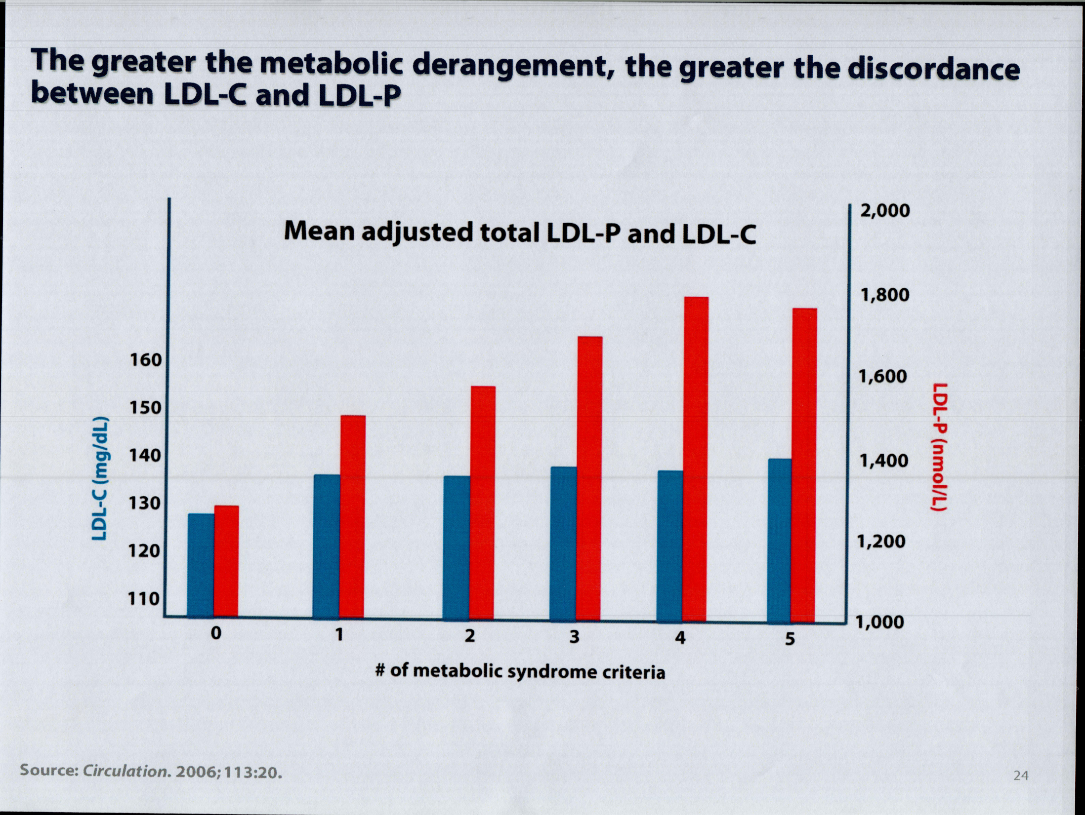
Passengers
Cars
End of story: It’s not the passengers, it’s the cars .

Slide 37
Is There A Simple Way To Identify Insulin Resistance?
Yes: A blood triglyceride/HDL ratio ≥ 3.5 provides a simple means of identifying insulin resistance.
Insulin Resistance occurs early. It is the canary in the coal mine. (20 year IR DM2)
Are you Insulin Resistant??? Do the math!
Insulin Resistance is reversible. (It’s our nation’s biggest public health problem.)
When we are insulin resistant, the particle number - LDL-P can be very, very high. That’s what causes the heart attack!
* Tracey McLaughlin, M.D., Gerald Reaven, M.D., Etc. amjcard 2005

Slide 39
The most forceful thing he said, the only time he raised his voice
somewhat, was at the evening presentation when he said: “In trial after trial, in five major trials, it’s the particle number that always most closely tracks risk.” William Cromwell, M.D. SpecialtyHealth Wellness Workshop, September, 2011 (Video #8 at specialtyhealth.com)
It’s not the passengers, it’s the cars!
Dr. Michael Richman
Understanding this critical lipid concept alone could save our cash strapped cities millions and millions of dollars, and help us avoid so many tragic events!

Slide 40
Compression of Morbidity
X
Quality of Life
Ideal
10
30
50
70
90
TIME
Notes:
Copyright 2002-2012, SpecialtyHealth, Inc. All rights reserved.
Reproduction forbidden without permission. www.specialtyhealth.com
W:Wellness and Prevention Marketing/Compression of Morbidity

Slide 41
DM

Slide 42
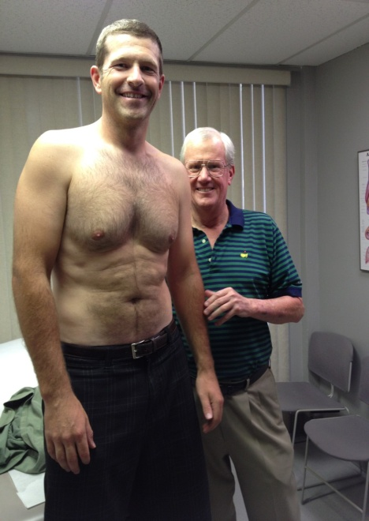
RISK ASSESSMENT
Officer “1” is close to ideal!
He is not fat, but
with a BMI of
about 28 he gets
the “Fat Boy” Letter.
Caliper testing and underwater weighing resolve these issues.
Vo2 Max testing, etc. reveals that he is extremely fit.
Advanced testing, although probably not necessary on this officer, was completed and as expected his LDL-P was under 1000!
His insulin resistance score was very low.
I tell him that he is “metabolically bullet proof”.

Slide 43
Compression of Morbidity
X
Quality of Life
X
Ideal
10
30
50
70
90
TIME
Notes:
Copyright 2002-2012, SpecialtyHealth, Inc. All rights reserved.
Reproduction forbidden without permission. www.specialtyhealth.com
W:Wellness and Prevention Marketing/Compression of Morbidity

Slide 44
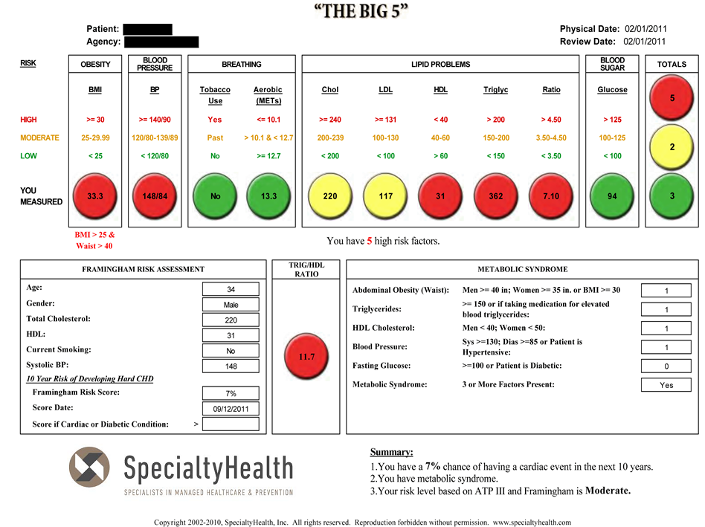
BEFORE THE PROGRAM
33

Slide 45
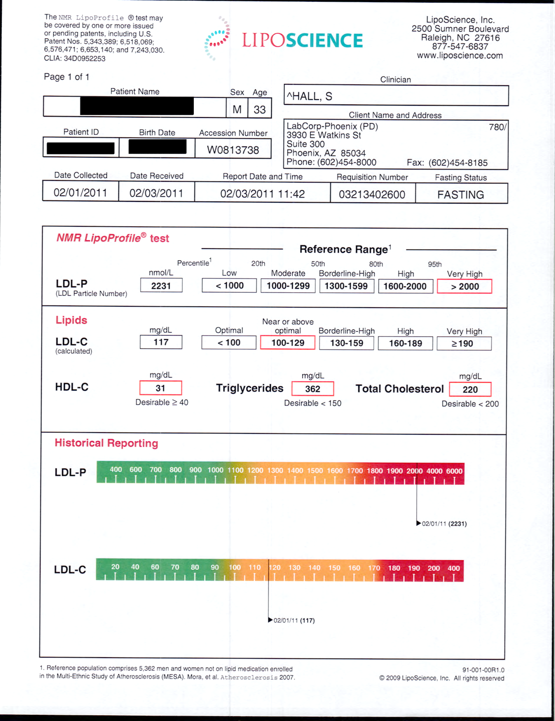

Slide 46
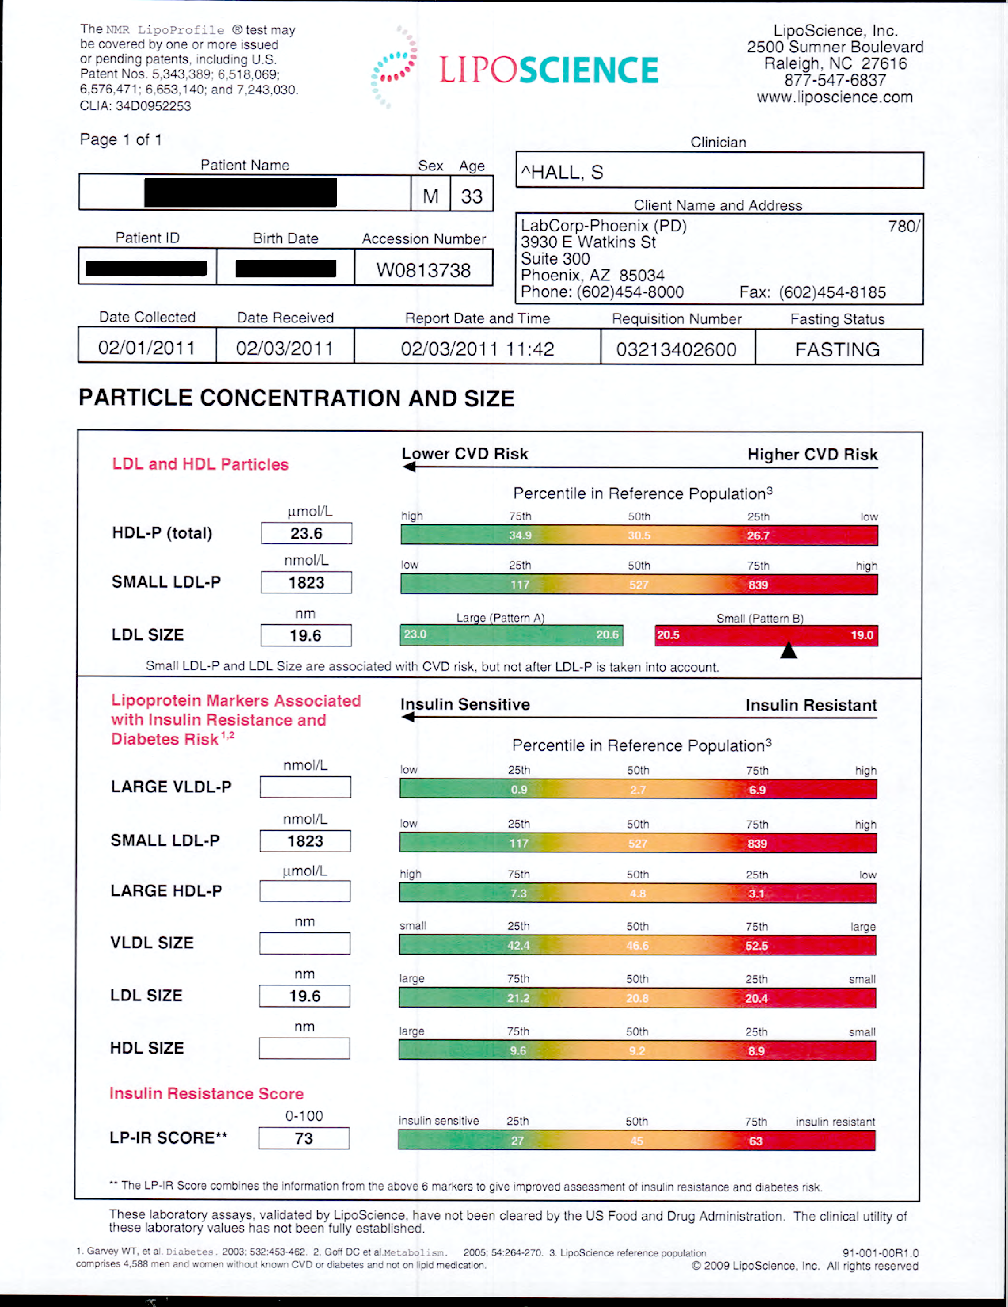

Slide 47
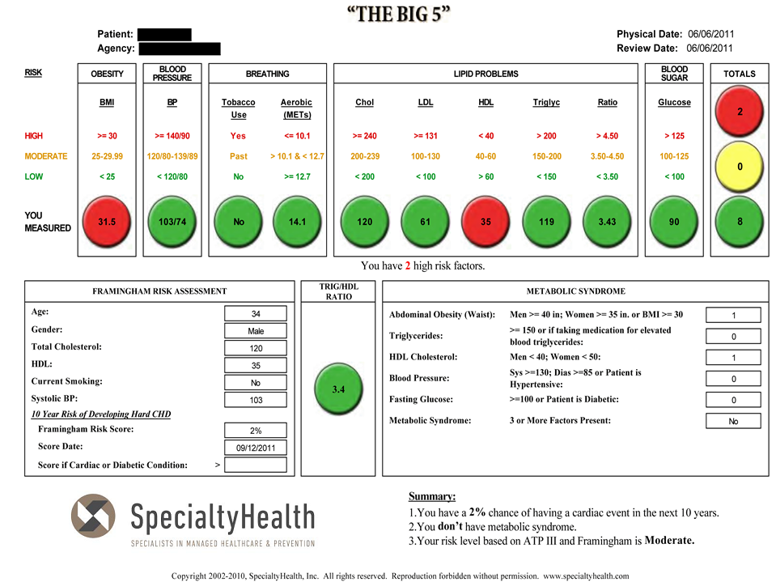
AFTER WELLNESS PROGRAM
33

Slide 48
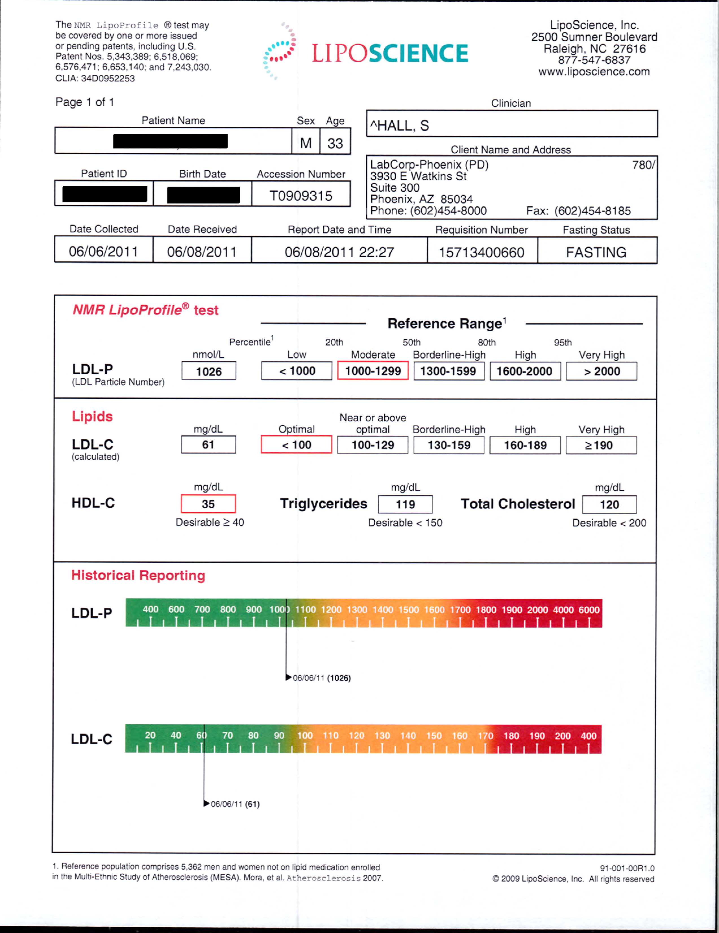

Slide 50
DOES IT WORK? Case Study 2
 | 2/1/11 BEFORE | 6/6/11 AFTER | 4 MONTH RESULT
WEIGHT | 219 | 207 |  | 5.4%
LDL-P | 2231 | 1026 |  | 1205
HDL-P | 23.6 | 28.7 |  | 5.1
LDL-C | 117 | 61 |  | 56
HDL-C | 31 | 35 |  | 4
TRYGLICERIDES | 362 | 119 |  | 243
INSULIN RESISTANCE SCORE | 73 | 57 |  | 16
These numbers are from a 33 year old high risk officer: The results were reached using a Low Carb Diet, Exercise, and a cheap Statin. These significant changes were seen in 4 months!
Get them to 1000 – Whatever it takes! (William Cromwell)
Copyright 2002-2012, SpecialtyHealth, Inc. All rights reserved. Reproduction forbidden without permission. www.specialtyhealth.com W:Wellness and Prevention Marketing/Our Best Cases

Slide 51
Insulin Resistance – Our Nation’s Biggest Public Health Problem
Sleep Apnea
Stroke, HTN, Gout
Heart Attack
Obesity
Insulin
Resistance
Diabetes Mellitus II
Polycystic Ovarian Syndrome
Chronic Kidney Disease
Alzheimer's Dementia
Certain Cancers
Smoking

Slide 52
So……how do we correct Insulin Resistance? It’s Surprisingly Inexpensive:
Paleo/Low Carb: (Robb Wolf, Gary Taubes, Dr. Robert H. Lustig – The Bitter Truth, Dr. William Cromwell, Dr. Loren Cordain and Dr. Tara Dall)
Exercise: (Ethan Opdahl, Tammy Lopes, Dr. Kevin Gilmartin, Robb Wolf, Rob Conatser, Dr. Scott Hall, Bill Land (our Navy Seal), and Dr. William Cromwell) )
Weight loss – if necessary: (Ethan Opdahl, Gary Taubes, Dr. Tracey Green, Robb Wolf, Dr. Thomas Dayspring, Dr. Tara Dall, and Dr. William Cromwell)
Possible medications, such as Statins or Metformin (Dr. Scott Hall, Dr. Grant
Anderson, Dr. Tara Dall, Dr. Thomas Dayspring, Dr. William Cromwell, and
many, many others)
TREAT TO AN LDL-P OF 1000
(Do whatever it takes!) (William Cromwell)
All slides subject to copyright 2002-2012, SpecialtyHealth, Inc. All rights reserved. Reproduction forbidden without permission. www.specialtyhealth.com

Slide 53
Compression of Morbidity
X
Quality of Life
X
Ideal
10
30
50
70
90
TIME
Notes:
Copyright 2002-2012, SpecialtyHealth, Inc. All rights reserved.
Reproduction forbidden without permission. www.specialtyhealth.com
W:Wellness and Prevention Marketing/Compression of Morbidity

Slide 54
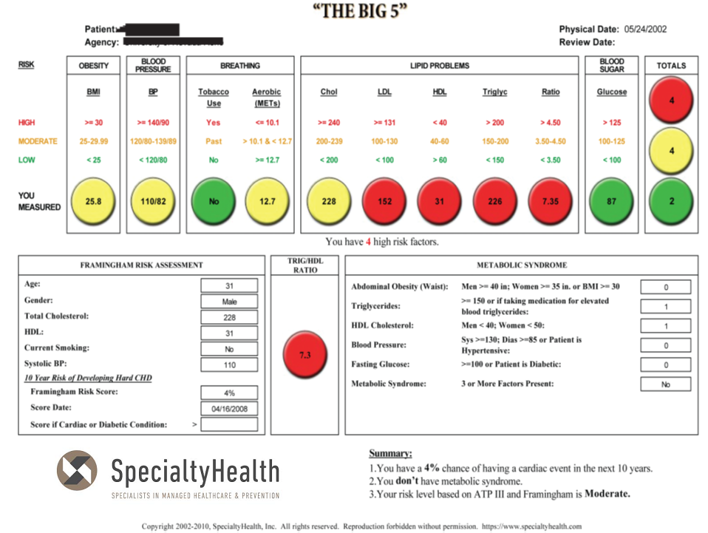
BEFORE WELLNESS PROGRAM

Slide 55
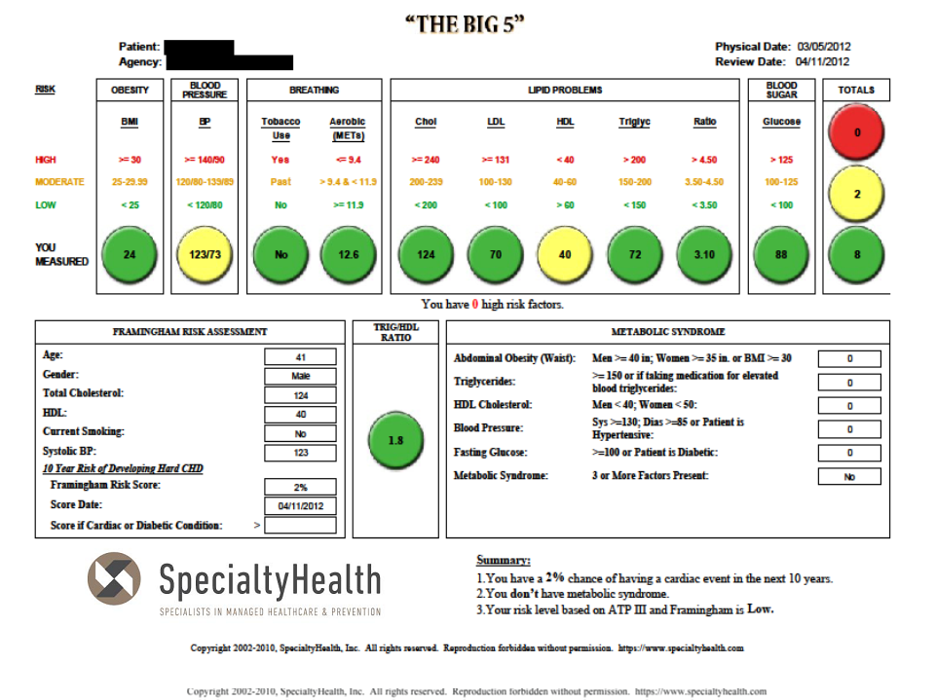
AFTER WELLNESS PROGRAM

Slide 57
DOES IT WORK? Case Study 3
 | 5/24/02 BEFORE | 3/5/12 AFTER | 10 YEAR RESULT
LDL-C | 152 | 70 |  | 82
HDL-C | 31 | 40 |  | 9
TRYGLICERIDES | 226 | 72 |  | 154
INSULIN RESISTANCE RATIO | 7.3 | 1.8 |  | 5.5
HIGH RISK – RED LIGHTS | 4 | 0 |  | 4
LDL-P (At goal under 1000) | 2500 | 845 |  | 1655
This high risk officer came to us at age 31. He had an incredible 10 year treatment success: The results were reached using a Low Carb Diet, Exercise and inexpensive medications.
Copyright 2002-2012, SpecialtyHealth, Inc. All rights reserved. Reproduction forbidden without permission. www.specialtyhealth.com
W:Wellness and Prevention Marketing/Our Best Cases

Slide 58
Compression of Morbidity
X
Quality of Life
X
Ideal
10
30
50
70
90
TIME
Notes:
Copyright 2002-2012, SpecialtyHealth, Inc. All rights reserved.
Reproduction forbidden without permission. www.specialtyhealth.com
W:Wellness and Prevention Marketing/Compression of Morbidity

Slide 59
BEFORE PROGRAM 2006

Slide 60
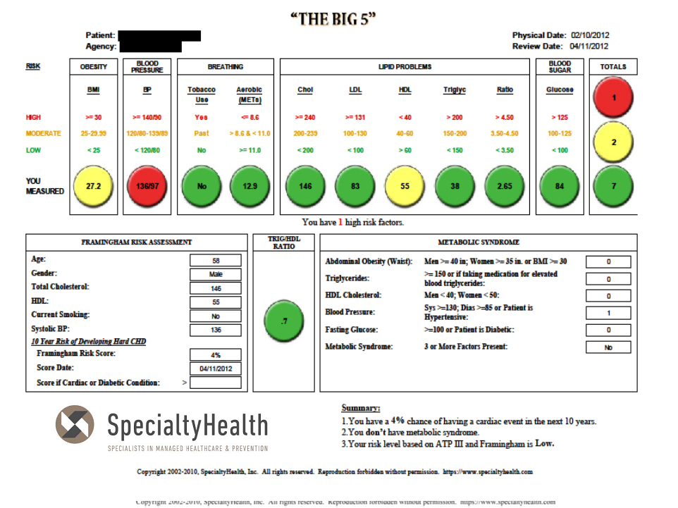
AFTER PROGRAM 2012

Slide 62
DOES IT WORK? Case Study 4
 | 2/1/06 BEFORE | 2/10/12 AFTER | 6 YEAR RESULT
WEIGHT | 235 | 195 |  | 40
WAIST | 43 | 38 |  | 5”
LDL-P | 2200 | 1096 |  | 1104
LDL-C | 106 | 83 |  | 23
HDL-C | 38 | 55 |  | 17
TRYGLICERIDES | 270 | 38 |  | 232
INSULIN RESISTANCE RATIO | 7.1 | .7 |  | 6.4
METABOLIC SYNDROME MARKERS | 5/5 | 1/5 |  | 4
This police officer was in real trouble in 2006. Now in 2012, no more “Dead Man Walking.”
He is a program advocate and has personally maintained it over the past 6 years.
YES IT WORKS!!
Copyright 2002-2012, SpecialtyHealth, Inc. All rights reserved. Reproduction forbidden without permission. www.specialtyhealth.com
W:Wellness and Prevention Marketing/Our Best Cases

Slide 63
Summary
We have seen that having a BMI of 28 doesn’t mean you are a “fat boy”.
We have defined Insulin resistance – the number one public health problem in the nation, and shown that it can be reversed. This has a tremendous health and cost implication.
Two “red line” cases have also been reversed – Testing and pharmacology become critical.
We now know that we can’t trust routine testing. We have seen the power of the NMR!
I want all of you to go home and take a look at your lab results. I want you to calculate
your Triglyceride/HDL ratio and e-mail me if it is above 3.5!!
Consider insulin resistance, consider NMR testing.
“It’s not the passengers, it’s the cars.”
We now know about Robb Wolf and Gary Taubes and understand that Paleo/Low Carb is
our preferred approach – The science has taken us there.
We are happy to help anyone in the first responder world, especially those who looked
at our work and enjoyed it.
E. James Greenwald, M.D.
greenie@specialtyhealth.com

